Slide 1
Prediction of Dengue Incidence Using Search Query Surveillance¹
1: Althouse, B. M., Ng, Y. Y., & Cummings, D. A. (2011). Prediction of dengue incidence using search query surveillance. PLoS neglected tropical diseases, 5(8), e1258

Slide 2
What is dengue?
Caused by the dengue virus
Transmitted by mosquitos bites
Symptoms : high fever, headache, vomiting
High incidence in Thailand and Singapore

Slide 3
Importance of dengue rises prediction for early intervention
Infection
Rise in dengue incidence
Public health education and deployment of medical teams

Slide 4
Studied cities with high dengue incidence
Bangkok
Singapore

Slide 5
Methodology
Data collection
Real epidemiologic datas
Data-fitted
Model
step-down linear
regression model
Predictions
Epidemiologic data of dengue cases from 2005-2011 in Singapore and Bangkok collected from the Ministry of Health of Singapore and the Thai bureau of epidemiology websites

Slide 6
Methodology
Data collection
Real epidemiologic datas
Data-fitted
Model
step-down linear
regression model
Predictions
Use of Google insights to look at dengue-related searched items
‘’dengue symptoms’’
‘’mosquito’’
etc.
Step-down regression linear model with dengue-related searched items as variables

Slide 7
Methodology
Data collection
Real epidemiologic data
Data-fitted
Model
step-down linear
regression model
Predictions
Prediction using the fitted-model for the year 2010

Slide 8
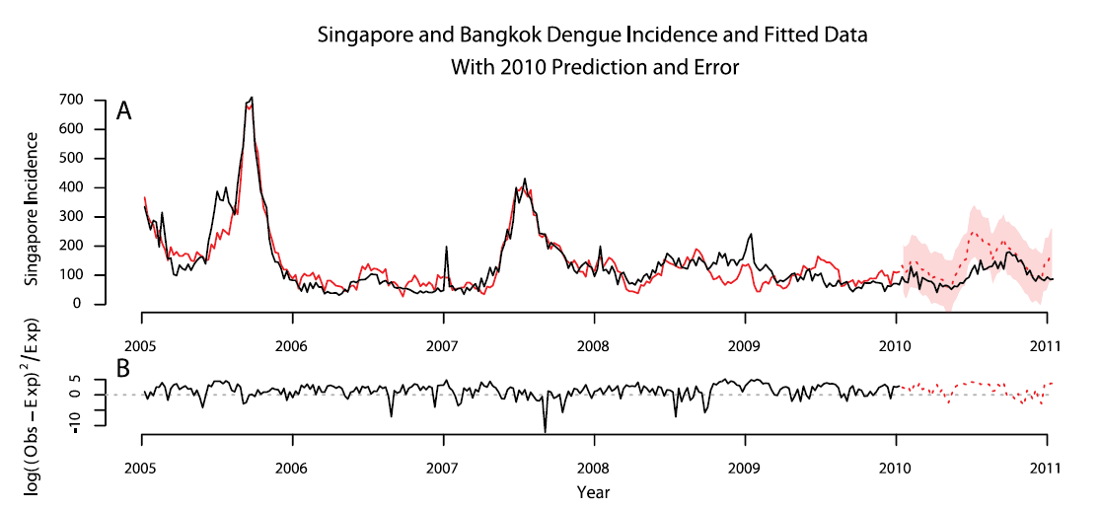
Singapore Incidence and Fitted Data/Prediction

Slide 9
Singapore Incidence and Fitted Data/Prediction
Observed dengue incidence
2005-2011

Slide 10
Singapore Incidence and Fitted Data/Prediction
Model fitted to data
2005-2010

Slide 11
Singapore Incidence and Fitted Data/Prediction
Predicted dengue incidence in 2010

Slide 12
Singapore Incidence and Fitted Data/Prediction
Error between observed incidence and model fit/prediction

Slide 13
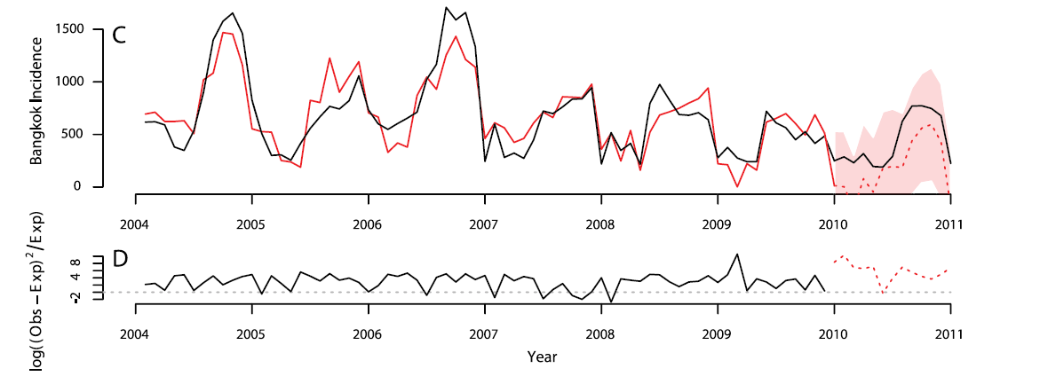
Bangkok Incidence and Fitted Data/Prediction

Slide 14
In summary
Development of models that can predict rises in dengue incidence in Bangkok and Singapore

Slide 15
Thanks!
Any questions ?

